Slide 1
A Simple Introduction to Scrum Master Certified(SMC)

Slide 2
Scrum Values
These values play a significant role in the success of agile teams because they give direction to:
How people work
Behave
Make decisions
Plan
Execute their tasks.
Every Scrum team understands the need for these values.
The 5 values are:
1. Commitment
2. Courage
3. Focus
4. Openness
5. Respect

Slide 3
Commitment
Commitment is central to the empirical process. At the same time, it fosters collaborative work – an essential aspect of the Scrum methodology.
This value, in the context of Scrum, covers the following:
The Scrum team commits to delivering quality work regardless of the challenges that come along the way.
Meet the sprint goal and work on the backlog items with the highest value.
Deliver a shippable product that meets the expectations of the customer.
Focus on the success of the team by promoting productive problem-solving, trust, and high team standards.
Dedication to doing their best.
Everyone in the Scrum team already understands what needs to be done and at what pace in order to meet their sprint goal.
Meanwhile, the Sprint Retrospective promotes the commitment to practice continuous improvement.

Slide 4
Courage
Courage is essential in solving complex problems and in growing high-performing teams.
Scrum is designed to address complex adaptive problems.
How else does courage apply in the Scrum methodology?
To be transparent in everyone’s progress, no matter how difficult the task is.
To hold others accountable for their respective roles and responsibilities.
To change the sprint backlog items after feedback by the customers.
Build something that no one has done before.
Share a opinion in a positive and encouraging manner.
Admit mistakes and shortcomings.
Additionally, the time-box nature of the sprint allows the Scrum team to try new things, experiment, and challenge the status quo.
Ultimately, the Sprint Retrospective allows the team to identify opportunities for improvement.

Slide 5
Focus
Regardless of everybody’s expertise, task and skills, they are focused on one end goal – deliver a high-quality product. Collaboration is essential to the success of the team.
Here’s how focus is practiced in agile teams:
Determine what needs to be tackled first.
During the sprint planning, the PO creates the epics, user stories, and tasks of the project and the members voluntary gets a task based on their skills and expertise.
Decide on what is the most important thing at the present moment and work on it first. Less time wasted.
Accept uncertainty and take steps to move forward.
Focus on the desired outcome.
The Scrum events and artifacts are what drive the focus and the time-box Sprint creates a sense of urgency.

Slide 6
Openness
Openness, as a Scrum value, fosters transparency. It simply means being honest. Scrum team members should keep no secrets relevant to their work and responsibilities.
Furthermore, organizations that adopt the agile framework is open and visible to feedback, inspection and adaptation.
Below are the ways in which openness is reflected in an agile framework:
Asking for help and guidance when necessary.
Offering help to one another.
Share their perspectives and support team decisions.
Admit mistakes and change direction.
The Product Backlog demonstrates openness as everyone gets to see what other people are working on.
Furthermore, the Sprint Retrospective drives openness to feedback and the need to change.

Slide 7
Respect
When there is respect, the Scrum team is able to maintain transparency and stick to their goals. It empowers the team to self-organize, solve problems, and collaborate with one another.
Respect is shown in many different Scrum dealings:
Respect and acknowledgement of the team’s diverse backgrounds, experiences, and range of skills.
Respect that everyone, despite being part of the team, has autonomy, purpose and mastery of their own skills.
Respect for everyone and the assumption that they all have good intentions.
Respect for all opinions and perspectives.
Respect is observed in all Scrum processes, from the Sprint planning to the product backlog creation, and Sprint Review.

Slide 8
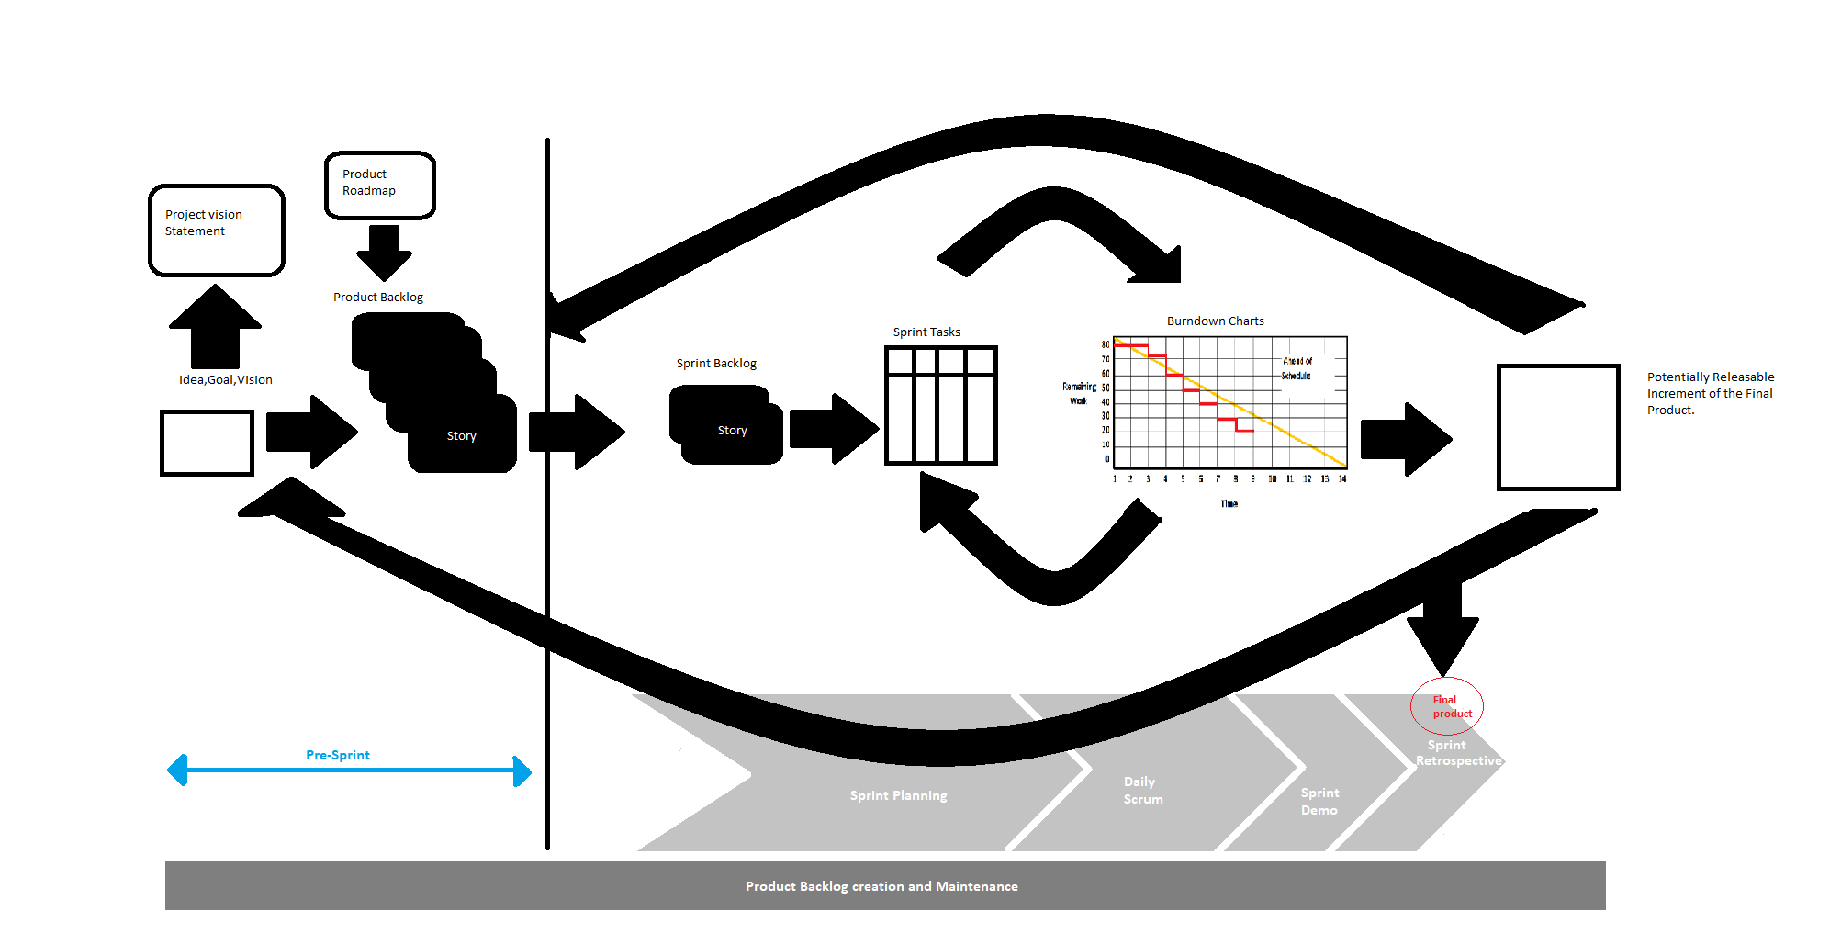
Scrum Overall Process

